Slide 1


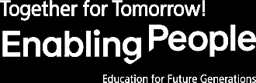

Slide 2


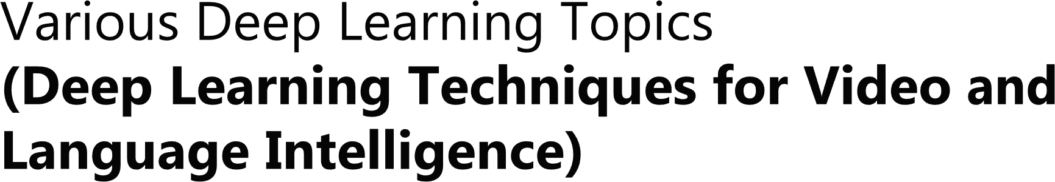

Slide 3


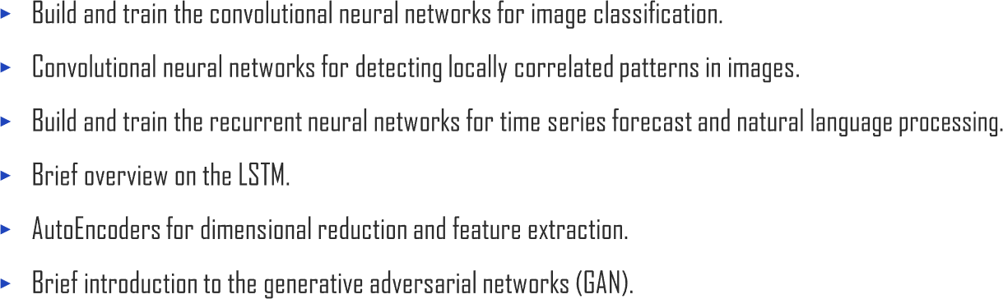


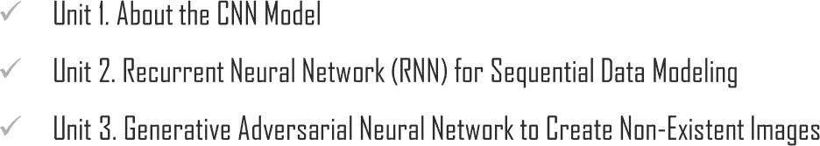
Chapter Description

Slide 4



Slide 5
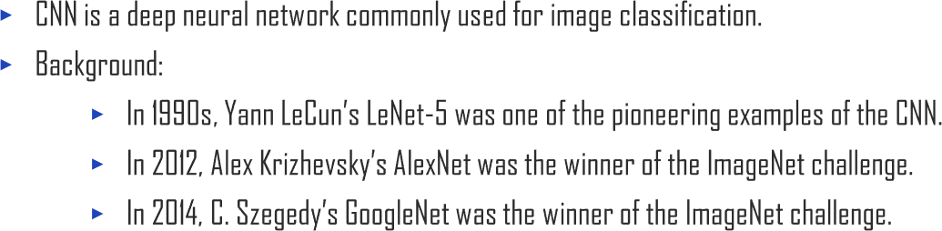
1.1. About the Convolutional Neural Network (CNN)
UNIT 01

Slide 6

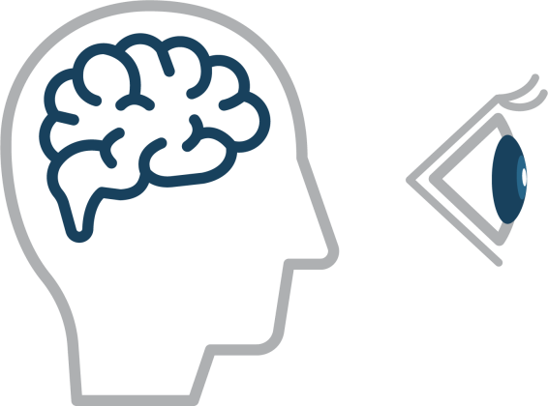
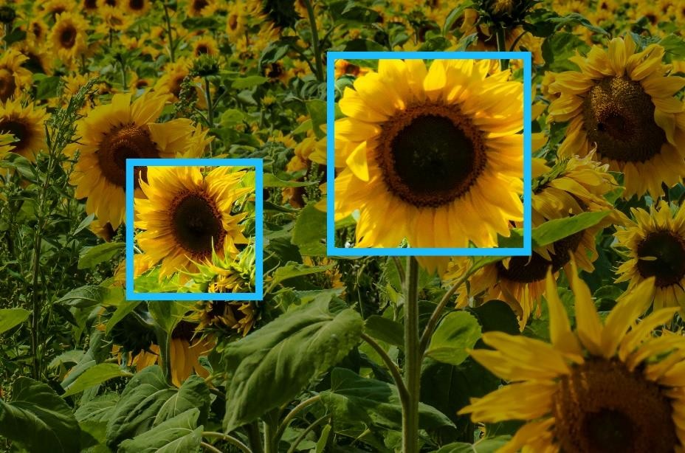


1.1. About the Convolutional Neural Network (CNN)
UNIT 01

Slide 7
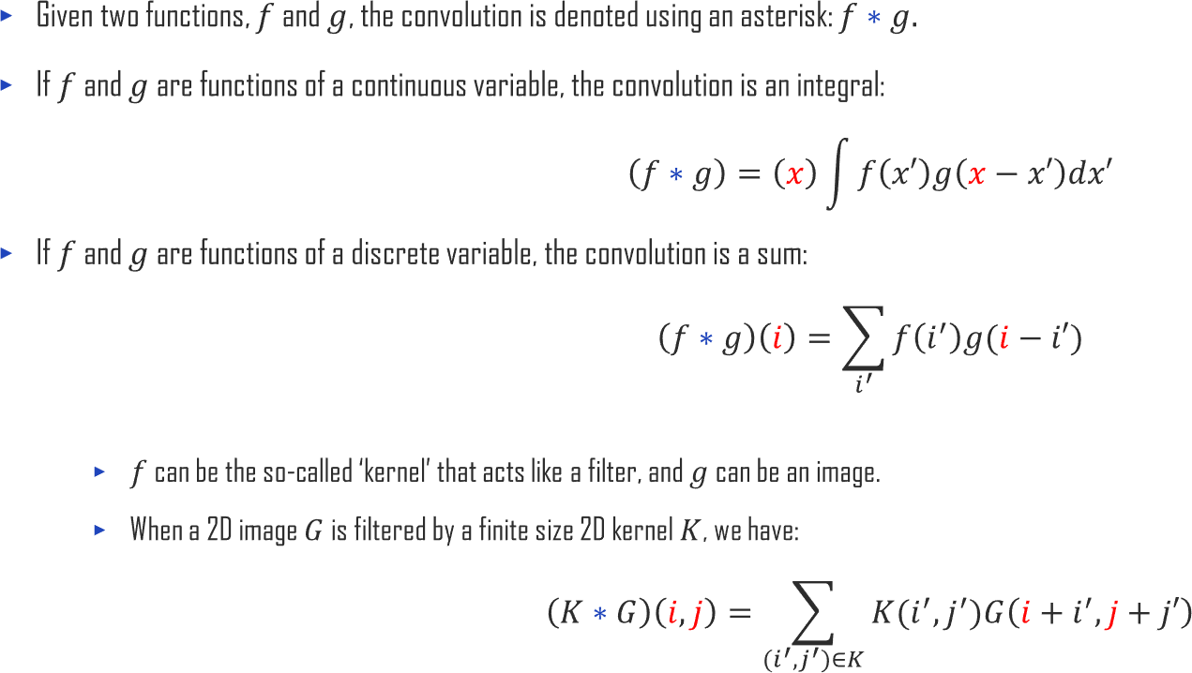
1.1. About the Convolutional Neural Network (CNN)
UNIT 01

Slide 8

1.1. About the Convolutional Neural Network (CNN)
UNIT 01

Slide 9

1.1. About the Convolutional Neural Network (CNN)
UNIT 01

Slide 10


1.1. About the Convolutional Neural Network (CNN)
UNIT 01

Slide 11

1.1. About the Convolutional Neural Network (CNN)
UNIT 01

Slide 12

1.1. About the Convolutional Neural Network (CNN)
UNIT 01
0 | 0 | 0 | 0 | 0 | 0
0 |  |  |  |  | 0
0 |  |  |  |  | 0
0 |  |  |  |  | 0
0 |  |  |  |  | 0
0 | 0 | 0 | 0 | 0 | 0

Slide 13

1.1. About the Convolutional Neural Network (CNN)
UNIT 01

Slide 14

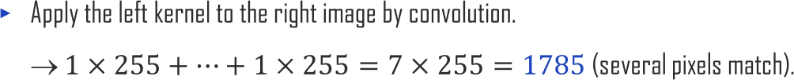
1.1. About the Convolutional Neural Network (CNN)
UNIT 01
0 | 0 | 0 | 0 | 0 | 0
0 | 0 | 0 | 0 | 0 |  | 0
0 | 0 | 0 | 0 |  | 0 | 0
0 | 0 | 0 |  | 0 | 0 | 0
0 | 0 |  | 0 | 0 | 0 | 0
0 |  | 0 | 0 | 0 | 0 | 0
 | 0 | 0 | 0 | 0 | 0 | 0
0 | 0 | 0 | 0 | 0 | 0
0 | 0 | 0 | 0 | 0 |  | 0
0 | 0 | 0 | 0 |  | 0 | 0
0 | 0 | 0 |  | 0 | 0 | 0
0 | 0 |  | 0 | 0 | 0 | 0
0 |  | 0 | 0 | 0 | 0 | 0
 | 0 | 0 | 0 | 0 | 0 | 0
*

Slide 15
1.1. About the Convolutional Neural Network (CNN)
UNIT 01

Slide 16
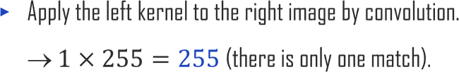
1.1. About the Convolutional Neural Network (CNN)
UNIT 01
0 | 0 | 0 | 0 | 0 | 0 | 1
0 | 0 | 0 | 0 | 0 | 1 | 0
0 | 0 | 0 | 0 | 1 | 0 | 0
0 | 0 | 0 | 1 | 0 | 0 | 0
0 | 0 | 1 | 0 | 0 | 0 | 0
0 | 1 | 0 | 0 | 0 | 0 | 0
1 | 0 | 0 | 0 | 0 | 0 | 0
255 | 0 | 0 | 0 | 0 | 0 | 0
0 | 255 | 0 | 0 | 0 | 0 | 0
0 | 0 | 255 | 0 | 0 | 0 | 0
0 | 0 | 0 | 255 | 0 | 0 | 0
0 | 0 | 0 | 0 | 255 | 0 | 0
0 | 0 | 0 | 0 | 0 | 255 | 0
0 | 0 | 0 | 0 | 0 | 0 | 255
*

Slide 17
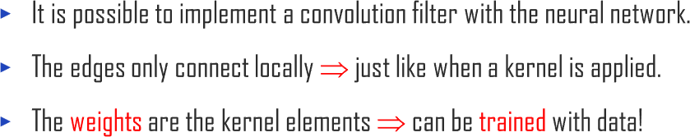

1.1. About the Convolutional Neural Network (CNN)
UNIT 01

Slide 18


1.1. About the Convolutional Neural Network (CNN)
UNIT 01

Slide 19
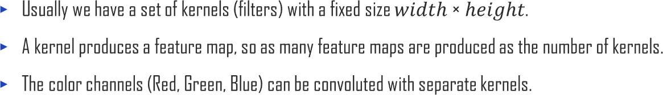





1.1. About the Convolutional Neural Network (CNN)
UNIT 01

Slide 20

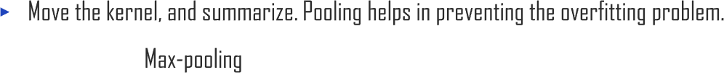

1.1. About the Convolutional Neural Network (CNN)
UNIT 01
Ex
0.3 | 0.2
0.1 | 0.0
0.3 | 0.1
0.2 | 0.5
0.3
0.5

Slide 21
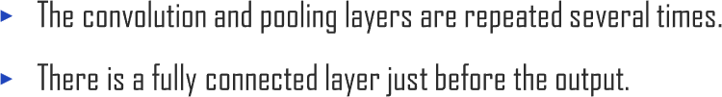


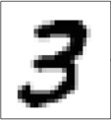





1.1. About the Convolutional Neural Network (CNN)
UNIT 01
Convolution layer
0
0
0.02
0.95
0.03
0
0
0
0
0
Pooling layer
Dropout layer
Fully connected layer

Slide 22


1.1. About the Convolutional Neural Network (CNN)
UNIT 01

Slide 23


1.1. About the Convolutional Neural Network (CNN)
UNIT 01

Slide 25
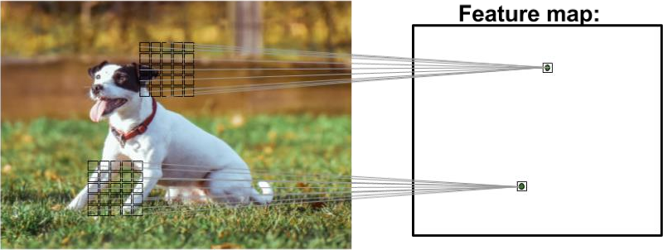
1.2. Components of Convolutional Neural Network (CNN)
UNIT 01
CNN can automatically learn the most useful features for the task from the original data.
The figure below shows a feature map generated from an input image.
Feature map:

Slide 26
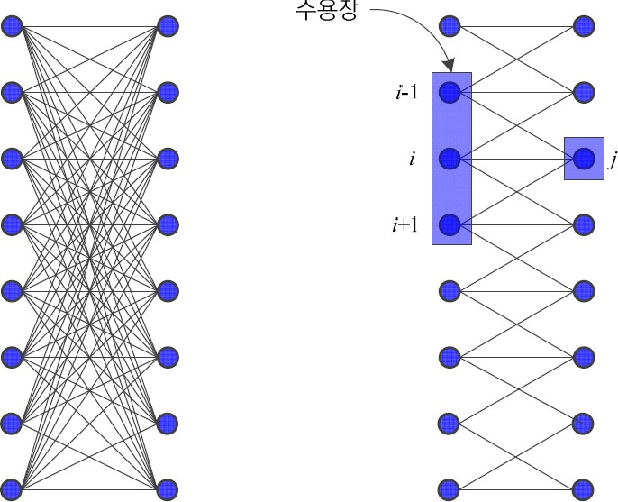
1.2. Components of Convolutional Neural Network (CNN)
DMLP
High complexity due to fully connected structure
Slow learning rate and possibility of overfitting
CNN
Layer 𝑙-1
Layer 𝑙
Receptive field
Layer 𝑙-1
Layer 𝑙
Partially connected structure (sparse connection) using convolution operation to reduce complexity
Convolution operation extracts useful features.
Suitable for data of grid structure (audio, video, etc.)
Its receptive field is analogous to human vision.
Able to process inputs of variable size
(a) DMLP (fully connected) (b) CNN (partially connected)
Partially connected structure and the receptive field of the CNN

Slide 27

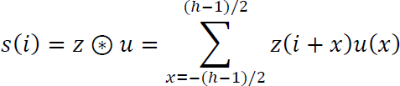
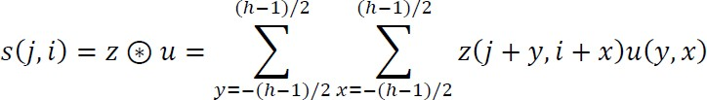
1.2. Components of Convolutional Neural Network (CNN)
UNIT 01
Convolution is a linear operation that multiplies the corresponding values and produces their sum.
u is a kernel, z is an input, s is an output (feature map)
1 dimensional input
2 dimensional input

Slide 28
1.2. Components of Convolutional Neural Network (CNN)
UNIT 01
Convolution is a simple linear operation that produces the sum of all the multiplied results of each corresponding unit.
On the left figure, if you execute a convolution operation that adds all the results of the multiplication of corresponding units of the values of the receptive field (1,20,2) and the kernel (0.3, 0.4, 0.3), the result is
1*(0.3) + 20*0.4 +2*0.3=8.9. If you move the kernel from left to right, such an operation is performed on all nodes, and the operation is complete.
2 2 9
−1 0 1
−1 0 1 , so the result of the operation is 21. If you move the kernel and apply the same operation to all nodes, you obtain a feature map on the right.
−1 0 1
In two dimensions, a convolution operation is similar to that of one dimension. The receptive field of the node is | 2 | 2 | 9 | , and the kernel is
 | 2 | 2 | 9
0 1 2 3 4 5 6 7
feature map
0 1 2 3 4 5 6 7
0
1
2
3
4
5
6
7
2 | 2 | 2 | 2 | 2 | 1 | 1 | 1
2 | 2 | 2 | 2 | 2 | 1 | 1 | 1
2 | 2 | 2 | 2 | 2 | 1 | 1 | 1
2 | 2 | 2 | 2 | 2 | 1 | 1 | 1
2 | 2 | 2 | 9 | 9 | 9 | 9 | 9
2 | 2 | 2 | 9 | 9 | 9 | 9 | 9
2 | 2 | 2 | 9 | 9 | 9 | 9 | 9
2 | 2 | 2 | 9 | 9 | 9 | 9 | 9
- | - | - | - | - | - | - | -
- | 0 | 0 | 0 | -3 | -3 | 0 | -
- | 0 | 0 | 0 | -3 | -3 | 0 | -
- | 0 | 7 | 7 | -2 | -2 | 0 | -
- | 0 | 14 | 14 | -1 | -1 | 0 | -
- | 0 | 21 | 21 | 0 | 0 | 0 | -
- | 0 | 21 | 21 | 0 | 0 | 0 | -
- | - | - | - | - | - | - | -
3 | 2 | 4 | 5 | 1 | 20 | 2 | 2
kernel
-1 | 0 | 1
-1 | 0 | 1
-1 | 0 | 1
kernel
0.3 | 0.4 | 0.3
feature map
- | 2.9 | 3.7 | 3.5 | 7.9 | 8.9 | 7.4 | -
(a) 1 dimensional convolution
(b) 2 dimensional convolution

Slide 29

1.2. Components of Convolutional Neural Network (CNN)
UNIT 01
Operation at the border of data is impossible since the kernel protrudes outside the data’s area.
In the previous slide, areas impossible for the operation were denoted with -. If a kernel’s size is h, and h is 3, the number of nodes becomes 2 in the border. In deep neural networks, convolution layers are repeated multiple times. Then, some nodes are omitted to a great degree.
To prevent such a problem, it performs what is called padding, as shown below. It pads a required amount of 0 or duplicates the value of the adjacent node.
0 1 2 3 4 5 6 7
0 1 2 3 4 5 6 7
0 | 3 | 2 | 4 | 5 | 1 | 20 | 2 | 2 | 0
3 | 3 | 2 | 4 | 5 | 1 | 20 | 2 | 2 | 2
0.3 | 0.4 | 0.3
0.3 | 0.4 | 0.3
1.8 | 2.9 | 3.7 | 3.5 | 7.9 | 8.9 | 7.4 | 1.4
2.7 | 2.9 | 3.7 | 3.5 | 7.9 | 8.9 | 7.4 | 2.0
(a) Padding 0
(b) Padding the adjacent value
Padding (grey colored nodes are padded nods.)

Slide 30
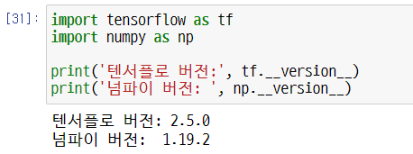
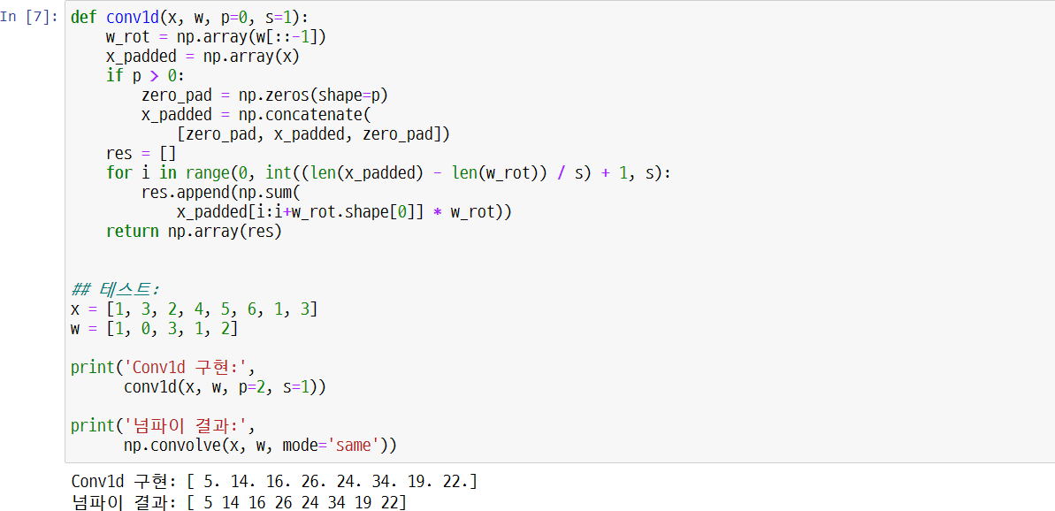
1.2. Components of Convolutional Neural Network (CNN)
UNIT 01
('TensorFlow version:', tf. version ) ('Numpy Version:', np. version )
TensorFlow version Numpy Version
## Test:
'Conv1d rendered:',
'NumPy Result:', Conv1d rendered
NumPy Result

Slide 31
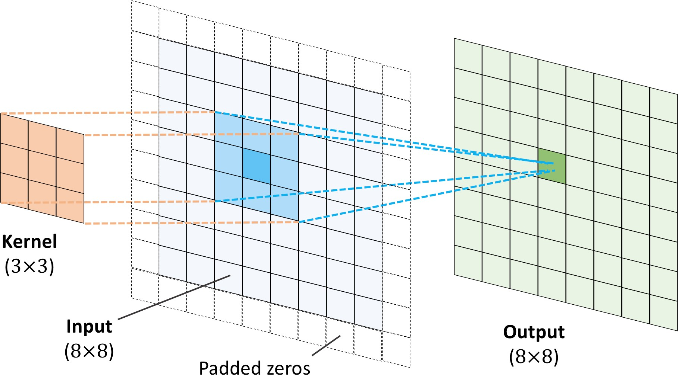
1.2. Components of Convolutional Neural Network (CNN)
UNIT 01
The figure below shows a convolution of 8 x 8 input matrix and 3 x 3 kernel.
p=1 and zeros are padded in the input matrix. Thus, 2D convolution generates an output of 8 x 8 size.
Kernel
(3 X 3)
Input (8 X 8)
Output (8 X 8)
Padded zeros

Slide 32
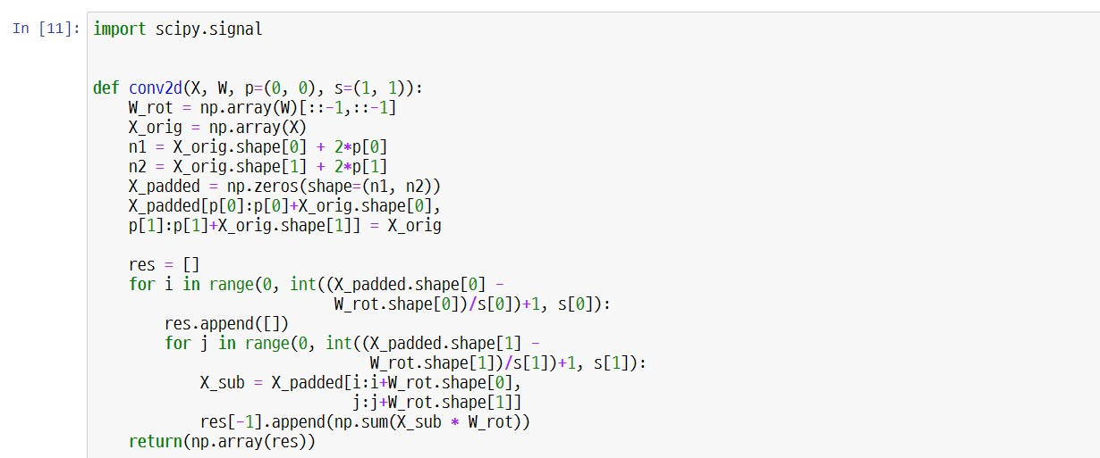
1.2. Components of Convolutional Neural Network (CNN)
UNIT 01
The code below is to implement 2D discrete convolution with the con2D function.

Slide 33
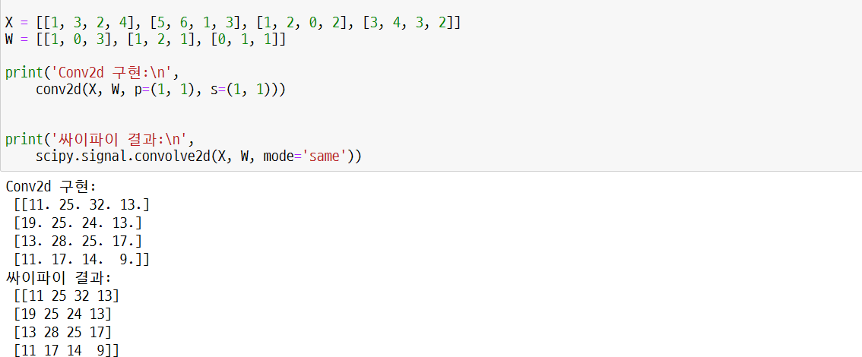
1.2. Components of Convolutional Neural Network (CNN)
UNIT 01
In scipy.signal, the function scipy.signal.convolve2d computes 2D discrete convolution.
('scipy results:\n',
Rendering Conv2d:
scipy results:
('Rendering Conv2d:\n',

Slide 34

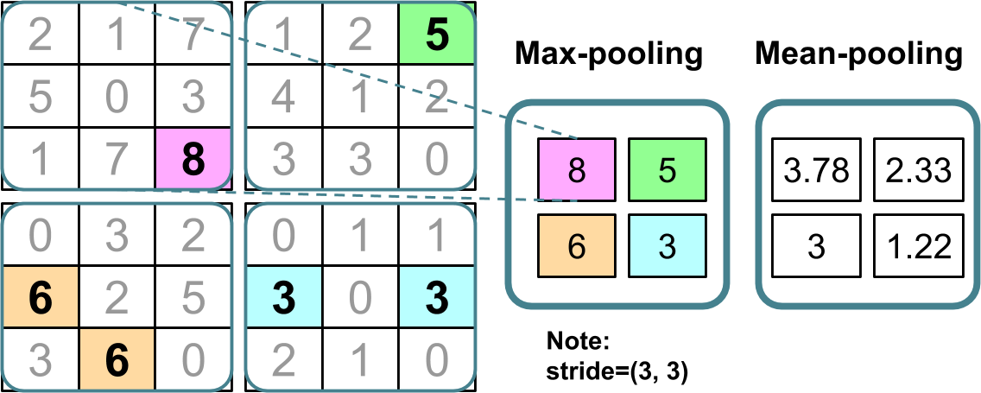
1.2. Components of Convolutional Neural Network (CNN)
UNIT 01
Sub-sampling is a typical pooling operation of two kinds that are applied to CNN.
Those are max pooling and mean-pooling (or average-pooling).
Generally, the pooling layer is denoted as Pn1×n2.
The subscript denotes the maximum value and the size of the adjacent pixel for mean-pooling.
The number of the adjacent pixels is the size of pooling.
Pooling (𝑷_{𝟑×𝟑})
Max-pooling
Mean-pooling
Note: Stride=(3, 3)

Slide 35

1.2. Components of Convolutional Neural Network (CNN)
UNIT 01
Pooling increases computation efficiency since it reduces the feature’s size.
Reduction of features also reduces chances of overfitting.
Pooling is still a central component of CNN structure, but some CNN structures are developed without using pooling layers.
They use a convolution layer of stride 2 instead of a pooling layer to reduce the feature map’s size.
A convolutional layer of stride 2 can be considered a pooling layer with learning weight.
For more information, refer to the journals comparing various CNN structures that use and don’t use pooling layers.

Slide 37
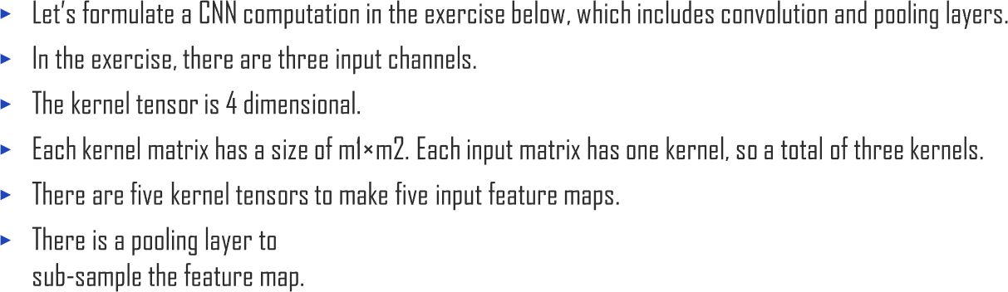
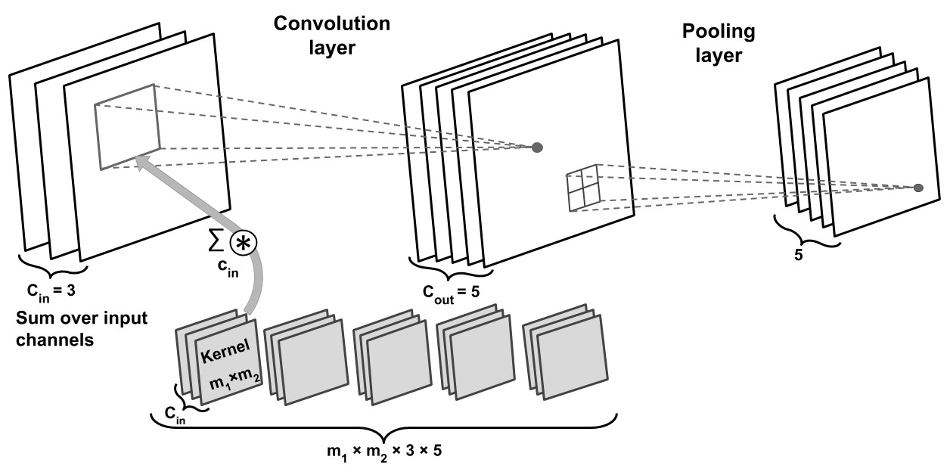
1.3. Building Deep Convolutional Neural Network using Basic Components
UNIT 01
Convolution
Pooling layer
layer
^{𝑐}in
𝑐
5
5
𝑐_{in} = 3
out ⁼
Sum over input channels
𝑚₁ × 𝑚₂ × 3 ×5

Slide 38
1.3. Building Deep Convolutional Neural Network using Basic Components
UNIT 01
For both fully connected neural network and CNN, it is difficult to determine the size of the network.
For quality performance, you need to tune the size of the weight matrix and the number of layers.
The capacity of a network indicates how complex a function can be approximated.
Networks with a relatively small number of parameters are prone to underfitting due to their small capacity.
The performance deteriorates because it cannot learn the inherent structure of the dataset.
However, a large network can easily become overfitted.
If such a network learns the training data, it will work fine on the training dataset but not in other datasets.

Slide 39
1.3. Building Deep Convolutional Neural Network using Basic Components
UNIT 01
In actual machine learning problems, you cannot know the appropriate network size beforehand.
You can solve such a problem with the method described below.
First, construct a relatively large network (one larger than actually needed) to work smoothly with a training dataset.
Then, to prevent overfitting, apply more than one regularization method to improve generalization performance on new datasets such as other test datasets.
This can prevent or reduce the effect of overfitting because regularization L1 and L2 add a penalty to the loss function, thus reducing the weight size during training.
Both L1 and L2 regularization can be used for neural networks, but L2 is used more frequently.
Then, there are methods such as dropout to regularize neural networks.

Slide 40
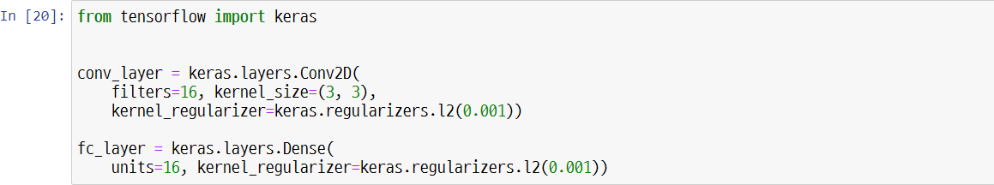
1.3. Building Deep Convolutional Neural Network using Basic Components
UNIT 01
With Keras API, as in the figure below, you can easily insert an L2 penalty to the loss function with kernel regularizer parameter (this is automatically reflected on the loss function).

Slide 41
1.3. Building Deep Convolutional Neural Network using Basic Components
UNIT 01
In the previous chapters, you have learned many activation functions such as ReLu, sigmoid, tanh, etc.
Some activation functions like ReLu use a hidden layer in the middle of the neural network to add non-linearity.
Functions such as sigmoid (for binary classification) and softmax (for multiclass classification) print the probability of class inclusion by being added to the last layer (output layer).
If the sigmoid or softmax activation function is not included in the output layer, the model will compute logit instead of the probability of class inclusion.
If the classification is the main issue, you should choose a suitable loss function for model training according to the type of the problem (binary or multiclass) and the type of the output (logit or probability)
Binary cross-entropy is a loss function for binary classification (with one output unit).
Categorical cross-entropy is a loss function for multiclass classification
Keras API offers two options for categorial cross-entropy loss.
In one option, the label is provided in one-hot representation (for example, [0, 0, 1, 0]. In another option, an integer label (for example, y=2) is provided.
For the latter, the term is also referred to as a ‘sparse’ expression in Keras.

Slide 42
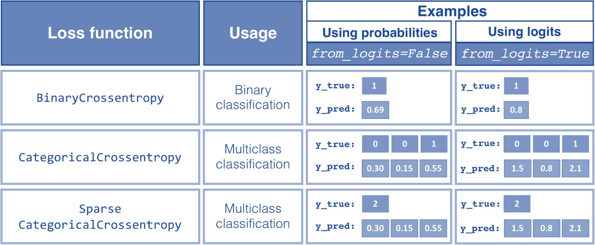
1.3. Building Deep Convolutional Neural Network using Basic Components
UNIT 01
The following chart shows three loss functions usable in Keras for multi-class classification in one-hot encoded and integer labels.
The three loss functions offer two options for receiving the prediction value: logit or class inclusion probability.
Examples
Loss function
Usage
Using probabilities
Using logits
Binary
Classification
Multiclass Classification
Multiclass Classification

Slide 43
1.3. Building Deep Convolutional Neural Network using Basic Components
UNIT 01
For numerical stability, it is generally preferred to compute cross-entropy loss by logit instead of class inclusion probability.
By using logit as an input for the loss function and designating logits=True, the corresponding TensorFlow function will more efficiently compute the derivate of the loss function for the loss and weight.
This is because you do not need to compute certain mathematical sections when logit is provided as input.

Slide 44
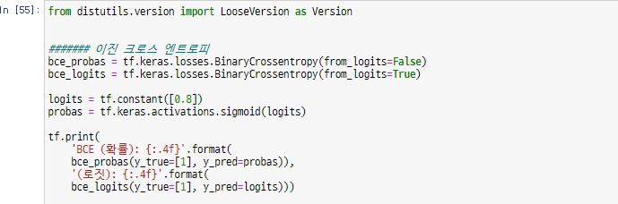

1.3. Building Deep Convolutional Neural Network using Basic Components
UNIT 01
####### Binary cross entropy
'BCE (probability): {:.4f}'.format(
'(logit): {:.4f}'.format(

Slide 45
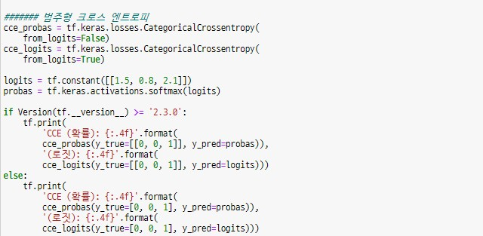

1.3. Building Deep Convolutional Neural Network using Basic Components
UNIT 01
####### Categorial cross entropy
'CCE (probability): {:.4f}'.format(
'(logit): {:.4f}'.format(
'CCE (probability): {:.4f}'.format(
'(logit): {:.4f}'.format(

Slide 46
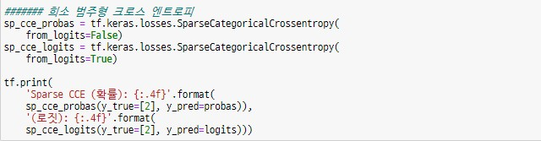
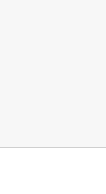
1.3. Building Deep Convolutional Neural Network using Basic Components
UNIT 01
####### Sparse categorial cross entropy
'Sparse CCE (probability): {:.4f}'.format( '(logit): {:.4f}'.format(
BCE (probability): 0.3711 (Logit): 0.3711
CCE (probability): 0.5996 (Logit): 0.5996
Sparse CCE (probability): 0.5996 (Logit): 0.5996

Slide 47
1.3. Building Deep Convolutional Neural Network using Basic Components
UNIT 01
Sometimes, categorical cross entropy is used for binary classification.
Ordinarily, a model returns an output value for each sample in binary classification.
This output can be seen as probability P [class=1] of the positive class (for example, class 1).
In binary classification problems, P[class=0] = 1 - P[class=1].
You do not need to add output units to generate the probability of a negative class.
Often, a sample receives two outputs, each identified as the probability for each class (P[class=0] or P[class=1]).
In such a case, it is recommended to normalize the output (that is, make the sum 1) using the softmax function instead of the logistic sigmoid.
Here, categorical cross entropy is the appropriate loss function.

Slide 49
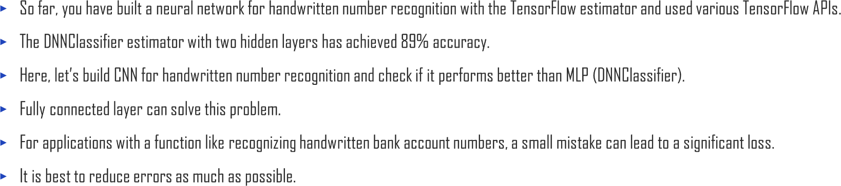
1.4. Building Convolutional Neural Network using TensorFlow
UNIT 01

Slide 50

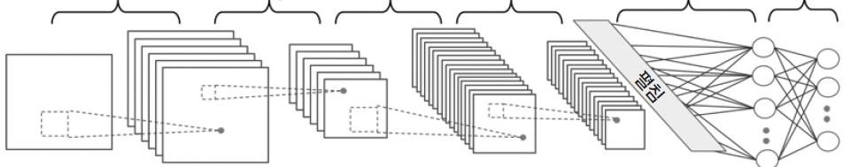
1.4. Building Convolutional Neural Network using TensorFlow
UNIT 01
The network structure for this exercise is shown in the figure below.
The input is a 28 x 28 greyscale image.
Dimension of the input tensor is batch size x 28 x 28 x 1, considering the number of channels (it is 1 since it’s a greyscale image) and the layout of the batch of the input
image.
Input data passes two convolutional layers with a 5 x 5 kernel.
The first convolution prints 32 feature maps, and the second prints 64 feature maps.
Each convolutional layer is followed by max pooling operation P2×2 for subsampling.
Then, the output of the fully connected layer is delivered to the second fully connected layer, the final softmax layer.
The next slide shows the network structure you are building.
Convolution 5x5x32
Convolution 5x5x64
Fully connected
Fully connected
Pooling 2 x 2
Pooling 2 x 2
28x28x1
28x28x28
14x14x32
14x14x64
7x7x64
1024 10

Slide 51
1.4. Building Convolutional Neural Network using TensorFlow
Each layer’s tensor dimension is as follows:
input: [batchsize×28×28×1]
convolution_1: [batchsize×28×28×32]
pooling_1: [batchsize×14×14×32] convolution_2: [batchsize×14×14×64] pooling_2: [batchsize×7×7×64]
fully connected_1: [batchsize×1024]
fully connected and softmax layer: [batchsize×10]
It maintains the dimension of the feature map and the input on the same level, using strides=1 on the convolutional layer.
The pooling layer sub-samples the image using strides=2 and reduces the size of the output feature map.
Let’s build this neural network using TensorFlow Keras API.

Slide 52
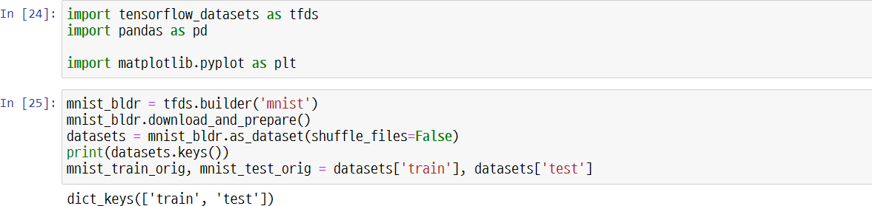
1.4. Building Convolutional Neural Network using TensorFlow
UNIT 01
MNIST Dataset
You learned two methods to load datasets using the tensorflow_datasets module.
One method follows three steps, and the other more straightforward method uses a load function encompassing these three steps.
The three steps for loading the MNIST dataset are as above.

Slide 53
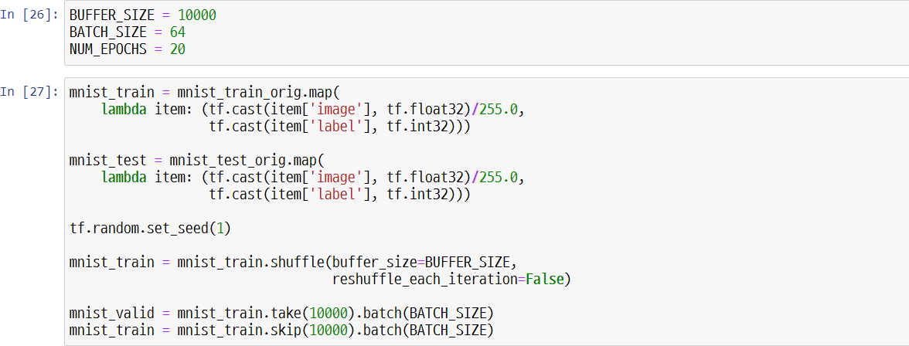
1.4. Building Convolutional Neural Network using TensorFlow
UNIT 01
You can split test dataset and validation dataset as follows (1/2):
The MNIST dataset is offered as a training dataset and test dataset.
Here, you will also create a validation dataset from the test dataset.
In the third step, you designate shuffle_files=False parameter in .as_dataset() method.

Slide 54
1.4. Building Convolutional Neural Network using TensorFlow
UNIT 01
You can split test dataset and validation dataset as follows (2/2):
This prevents initial shuffling.
This is because it has to split the test dataset into smaller test datasets and validation datasets.

Slide 55
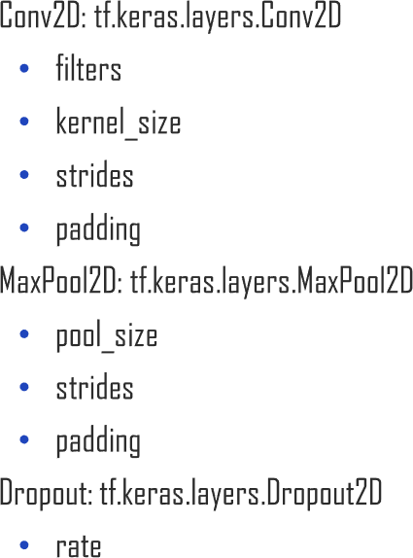
1.4. Building Convolutional Neural Network using TensorFlow
UNIT 01
Stack convolution, pooling, dropout, and fully connected layers using Keras Sequential class to build CNN in TensorFlow. Keras layer API offers a class for each of these layers.
To build a layer with Conv2D class, designate the number of filters (number of output feature maps) and size of the kernel. In addition, more parameters can modify the operations of the convolutional layer. The most widely used are stride (initial value is 1 in x, y dimensions) and padding. Padding can be either designated as the same padding or valid padding.
tf.keras.layers.Conv2D: a two-dimensional convolution layer
tf.keras.layers.MaxPool2D and tf.keras.layers.AvgPool2D
: sub-sampling (max pooling and meanpooling) layers
tf.keras.layers.Dropout
: a layer executing dropout for regularization.

Slide 56
1.4. Building Convolutional Neural Network using TensorFlow
UNIT 01
Two convolutional layers are added to the model.
Each convolutional layer uses a 5x5 kernel and the ‘same’ padding.
As mentioned, using padding=‘same’ preserves the feature map’s space-directional dimension (vertical and horizontal).
Input and output have the same height and width (the number of channels changes depending on the number of filters).
Max pooling layer of size 2 x2 and stride 2 reduces space-directional dimension to its half.
If the strides parameter is not designated on MaxPool2D, it is initialized with the pooling size.

Slide 57
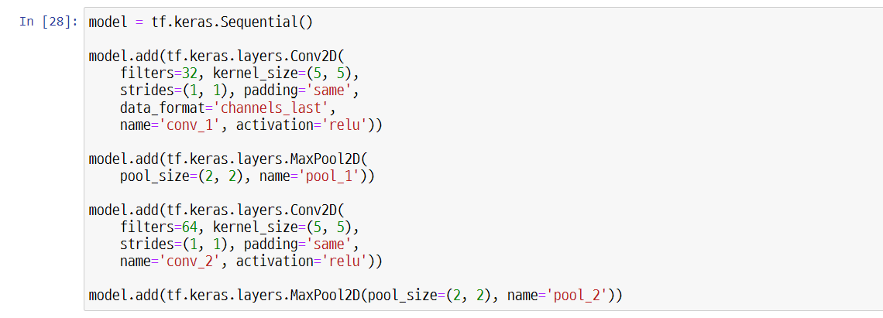
1.4. Building Convolutional Neural Network using TensorFlow
UNIT 01

Slide 58
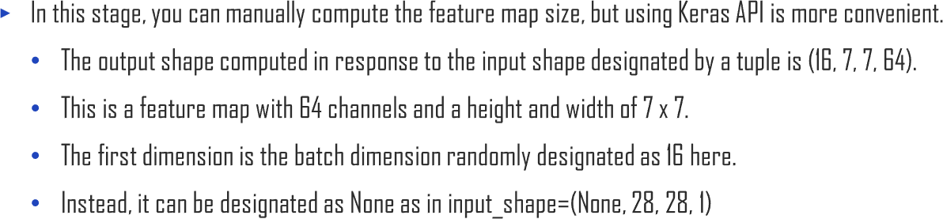
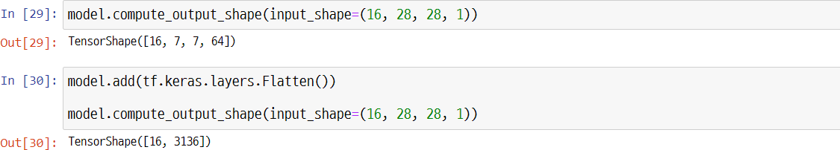
1.4. Building Convolutional Neural Network using TensorFlow
UNIT 01
The next layer to be added is a dense (or fully connected) layer.
It is necessary to build a classifier on top of the convolution and pooling layer.
The input of this layer is rank 2, that is, [batch size x number of input units].
The output of the previous layer must be spread in accordance with the dense layer.

Slide 59
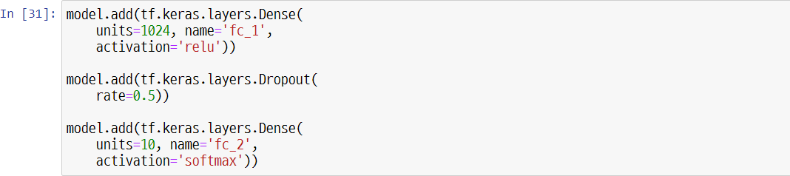
1.4. Building Convolutional Neural Network using TensorFlow
UNIT 01
fc_2, the fully connected layer, has ten output units corresponding to ten class labels from the MNIST dataset.
Moreover, it uses the softmax activation function to acquire the class inclusion probability of the input sample.
Sum of each sample’s probability is 1. One sample can belong to only one class.
Referring to the ‘loss functions for classification’ section, what loss function should be used here?
Multi-class classification using integer (sparse) label (not one-hot encoded label) uses SparseCategoricalCrossentropy.

Slide 60
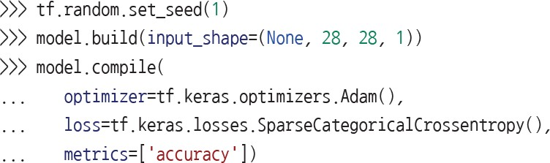
1.4. Building Convolutional Neural Network using TensorFlow
UNIT 01
This model is trained by the fit() method.
Suppose that you use a method well-prepared for training and evaluation (the evaluate() and predict() methods). It automatically configures the mode of the
dropout layer and appropriately controls the scale of the hidden units’ output.

Slide 61
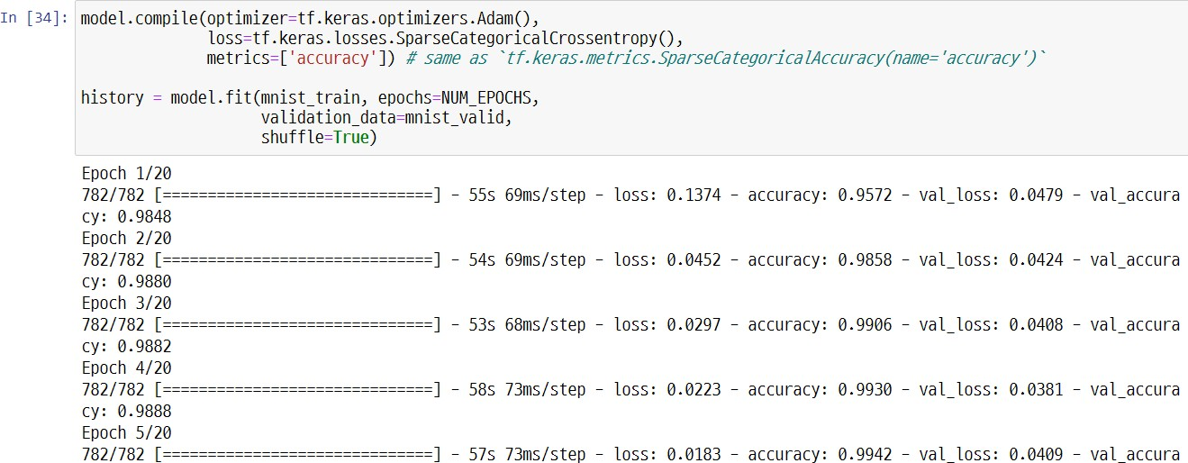
1.4. Building Convolutional Neural Network using TensorFlow
UNIT 01

Slide 62
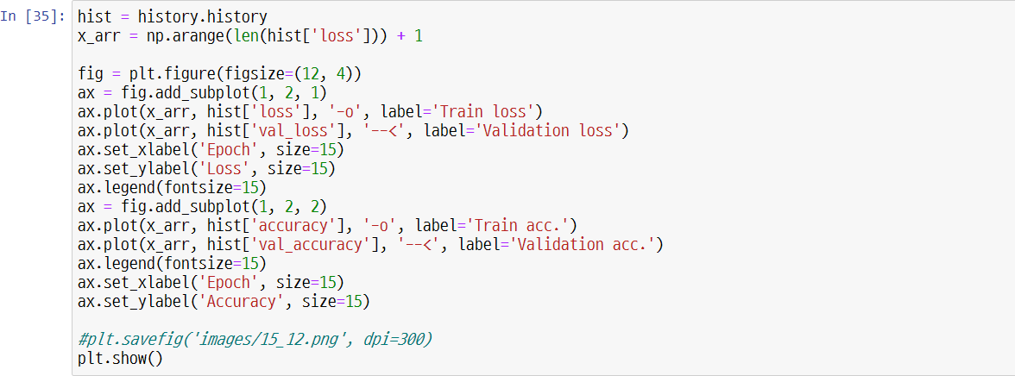

1.4. Building Convolutional Neural Network using TensorFlow
UNIT 01

Slide 63
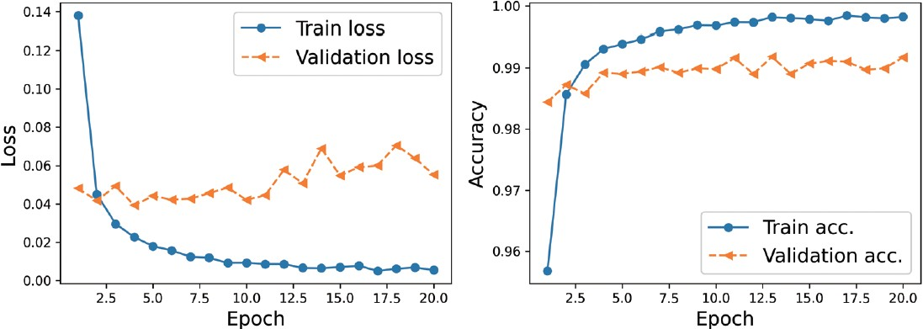
1.4. Building Convolutional Neural Network using TensorFlow
UNIT 01
Train loss
Validation loss
Loss
Accuracy
Train acc. Validation acc.
Epoch
Epoch

Slide 64
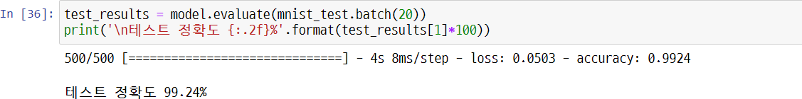
1.4. Building Convolutional Neural Network using TensorFlow
UNIT 01
'\n test accuracy {:.2f}%'.format(test_results[1]*100))
test accuracy

Slide 65
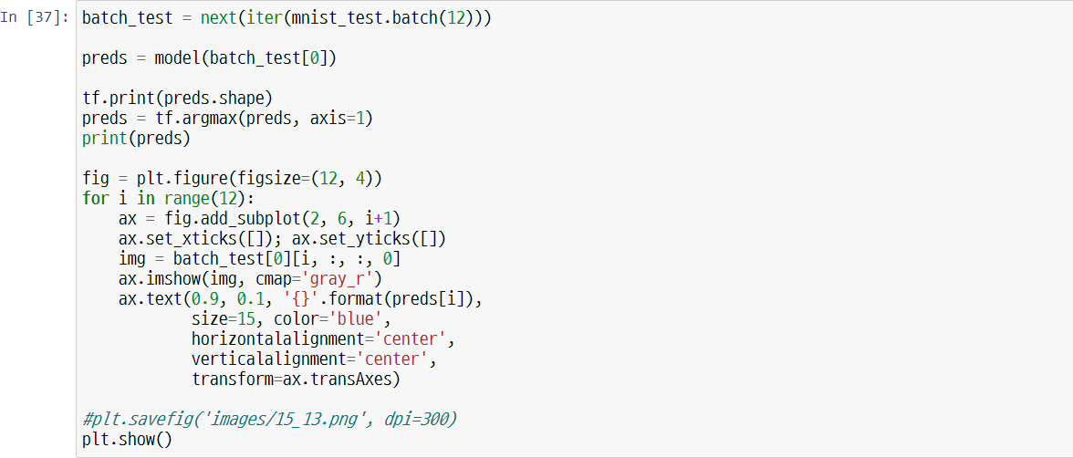
1.4. Building Convolutional Neural Network using TensorFlow
UNIT 01

Slide 66
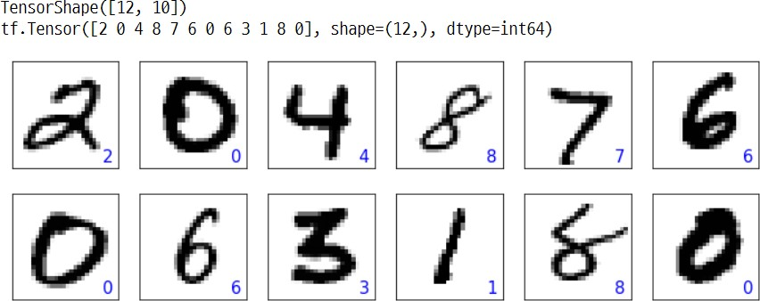
1.4. Building Convolutional Neural Network using TensorFlow
UNIT 01

Slide 67

1.4. Building Convolutional Neural Network using TensorFlow
UNIT 01

Slide 68



Slide 69

2.1. About the Recurrent Neural Network (RNN)
UNIT 02

Slide 70



2.1. About the Recurrent Neural Network (RNN)
UNIT 02

Slide 71










2.1. About the Recurrent Neural Network (RNN)
UNIT 02

Slide 72





2.1. About the Recurrent Neural Network (RNN)
UNIT 02

Slide 73






2.1. About the Recurrent Neural Network (RNN)
UNIT 02

Slide 74

2.1. About the Recurrent Neural Network (RNN)
UNIT 02

Slide 75

2.1. About the Recurrent Neural Network (RNN)
UNIT 02

Slide 77



2.2. Long Short Term Memory Cell
UNIT 02
×
+
tanh
×
×
σ
σ
tanh
σ

Slide 78
2.2. Long Short Term Memory Cell
UNIT 02
×
+
tanh
×
×
σ
σ
tanh
σ

Slide 79




2.2. Long Short Term Memory Cell
UNIT 02

Slide 80




Slide 81


3.1. AutoEncoder
UNIT 03

Slide 82










3.1. AutoEncoder
UNIT 03

Slide 83




3.1. AutoEncoder
UNIT 03

Slide 84





3.1. AutoEncoder
UNIT 03

Slide 85
3.1. AutoEncoder
Encoder neural network
Encoder neural network encodes p dimensional vector z (that is, z ∈ Rp), which is received from d dimensional input feature vector related to sample x (that is, x ∈ Rd). In other words, the encoder’s role is to learn how to model the z = f(x) function.
The encoded vector z is called a latent vector or latent feature expression.
Generally, the dimension of a latent vector is smaller than that of an input sample. That is, p < d.
It can be said that the encoder compresses data.
Decoder neural network
The decoder decompresses from lodimensional latent vector z.
Decoder can be considered as function = g(z).
w-

Slide 86


3.1. AutoEncoder
Latent vector
encoder
decoder

Slide 87

3.1. AutoEncoder
UNIT 03

Slide 88

3.1. AutoEncoder
UNIT 03

Slide 89


Slide 90

3.2. About the Generative Adversarial Networks (GAN)
UNIT 03

Slide 91



3.2. About the Generative Adversarial Networks (GAN)
UNIT 03
𝑧
∼_{𝜒}
Generative model

Slide 92

3.2. About the Generative Adversarial Networks (GAN)
UNIT 03

Slide 93

3.2. About the Generative Adversarial Networks (GAN)
UNIT 03

Slide 94


3.2. About the Generative Adversarial Networks (GAN)
UNIT 03
Generative Adversarial Networks (GAN) were introduced by Ian Goodfellow in 2014. To easily explain GAN, he first took the case of a counterfeiter
(Generator) and the police (Discriminator).
Data of real notes
Noise
Generator
Fake notes
Discriminator
Real money? Fake money?
The Generator should make the fake money as real as possible so that the Discriminator cannot detect the fake money!

Slide 95

3.2. About the Generative Adversarial Networks (GAN)
UNIT 03
Data of real notes
Noise
Generator
Fake notes
Discriminator
Real money?
Fake money?

Slide 96



3.2. About the Generative Adversarial Networks (GAN)
UNIT 03
𝑧
Fake(synthetic)
image
generator
discriminator
1: real
0: fake
Real image

Slide 97

3.2. About the Generative Adversarial Networks (GAN)
UNIT 03

Slide 98

3.2. About the Generative Adversarial Networks (GAN)
UNIT 03
𝑉(𝜃^((𝐷) ), 𝜃^((𝐺) ) )=𝐸_(𝑥~𝑝_𝑑𝑎𝑡𝑎 (𝑥)) [log(𝐷(𝑥))\]+𝐸_(𝑧~𝑝_𝑧 (𝑧) ) [log〖(1−𝐷(𝐺(𝑧)))〗]
V(θ(D), θ(G)) is called a value function.
This can be considered compensation.
You need to maximize this value for the discriminator (D) and minimize this value for the generator (G):
min max 𝑉(𝜃 ^{𝐷} , 𝜃^{(𝐺)})
𝐺 𝐷
D(x) is a probability that shows whether the input sample x is real or fake.
𝐸_(𝑥~𝑝_𝑑𝑎𝑡𝑎 (𝑥)) [log𝐷(𝑥) ] shows the expected value of the expression in the bracket in regards to the sample from the data distribution (distribution from the real sample).
𝐸_(𝑧~𝑝_𝑧 (𝑧) ) [log〖(1−𝐷(𝐺(𝑧)))〗] shows the expected value of the expression in the bracket in regards to the input vector z.

Slide 99

3.2. About the Generative Adversarial Networks (GAN)
UNIT 03
Iterate these in every training repetition.
Let’s suppose you are fixating the generator neural network and optimizing the discriminator.
Both terms of the value function V(θ(D), θ(G)) contribute to the optimization of the discriminator.
The first term is loss related to the real sample.
The second term is loss related to the fake sample.
If you fix G, the objective function serves to maximize V(θ(D) θ(G)).
That is, making the discriminator better distinguish between real and fake images.

Slide 100


3.2. About the Generative Adversarial Networks (GAN)
UNIT 03
To solve such a problem, you can write the objective function intended for
minimization min 𝐸_{𝑧~𝑝𝑧(𝑧)}[log(1 − 𝐷(𝐺(𝑧)))] as max 𝐸_{𝑧~𝑝𝑧 𝑧} [log(𝐷(𝐺(𝑧)))].
𝐺 𝐺
Modifying the expression as such means swapping the images of real and fake samples during generator training and finding the minimal value of the general function. In other words, it is the label change to 1 even though it is 0 because the synthetic sample is fake.
Then, instead of maximizing max 𝐸_{𝑧~𝑝𝑧 𝑧} [log(𝐷(𝐺(𝑧)))],
𝐺
you can minimize binary cross entropy loss with the new label.

Slide 101


3.2. About the Generative Adversarial Networks (GAN)
UNIT 03
Output
(prediction)
Answer label
Step 1 : deliver a real sample
discriminator
P(y=“real”∣𝑥)
y=“real”
Step 2 : generate a fake sample and deliver it to
the discriminator
generator
∼
y=“fake”
discriminator
P(y=“real”∣𝑥)
Step 3 : train the discriminator
Step 4 : train the generator (based on the discriminator’s predictions)
discriminator
P(y=“real”∣𝑥)
y=“real”
P(y=“real”∣ ∼
𝑥)
y=“fake”
∼
y=“real”
generator
P(y=“real”∣𝑥)
figure GAN training process

Slide 102
3.2. About the Generative Adversarial Networks (GAN)
UNIT 03
Output
(prediction)
Answer label
Step 1 : deliver a real sample
discriminator
P(y=“real”∣𝑥)
y=“real”
Step 2 : generate a fake sample and deliver it to
the discriminator
generator
∼
y=“fake”
discriminator
P(y=“real”∣𝑥)
Step 3 : train the discriminator
Step 4 : train the generator (based on the discriminator’s predictions)
discriminator
P(y=“real”∣𝑥)
y=“real”
P(y=“real”∣ ∼
𝑥)
y=“fake”
∼
y=“real”
generator
P(y=“real”∣𝑥)
figure GAN training process

Slide 104

3.3. Generative Adversarial Networks Exercise
UNIT 03

Slide 105


3.3. Generative Adversarial Networks Exercise
UNIT 03

Slide 106

3.3. Generative Adversarial Networks Exercise
UNIT 03

Slide 107

3.3. Generative Adversarial Networks Exercise
UNIT 03

Slide 108

3.3. Generative Adversarial Networks Exercise
UNIT 03
Training GAN model in Google Colab.ipynb
File
 | Edit | View | Insert | Runtime | Tool
Help
All changes saved
+ code
+ text
("GPU compatibility: ", len(tf.config.list_physical_devices('GPU')) > 0)
GPU compatibility True

Slide 109


3.3. Generative Adversarial Networks Exercise
UNIT 03

Slide 110


3.3. Generative Adversarial Networks Exercise
UNIT 03
## Define the generator
## Define the discriminator
function:
function:

Slide 111


3.3. Generative Adversarial Networks Exercise
UNIT 03

Slide 112

3.3. Generative Adversarial Networks Exercise
UNIT 03

Slide 113


3.3. Generative Adversarial Networks Exercise
UNIT 03

Slide 114

3.3. Generative Adversarial Networks Exercise
UNIT 03

Slide 115

3.3. Generative Adversarial Networks Exercise
UNIT 03
('before preproceessing:
')
('minimum: {} maximum: {}'.format(np.min(example), np.max(example)))
('after preproceessing:
')
'minimum: {} maximum: {}'.format(np.min(example),
np.max(example)))
after preproceessing:
before preproceessing:
minimum: 0 maximum:
255
minimum: -0.8737728595733643 maximum:
0.9460210800170898

Slide 116

3.3. Generative Adversarial Networks Exercise
UNIT 03
shap
e
shap
e
shap
eshap e

Slide 117


3.3. Generative Adversarial Networks Exercise
UNIT 03
Two logits, d_logits_fake and d_logits_real, are used to compute the loss function during training.
('Generator output -- shape:', g_output.shape)
('discriminator (real) -- shape:',
^{d}(_'^{l}dºi^{g}s^{i}c^{t}r^{s}i_m^{r}i^{e}na^{l}t.o^{s}r^{ha}(^{p}f^{e}a⁾ke) -- shape:', d_logits_fake.shape)
(Generator output -- shape: (32, 784)
(discriminator (real) -- shape: (32, 1)
(discriminator (fake) -- shape: (32, 1)

Slide 118



3.3. Generative Adversarial Networks Exercise
UNIT 03
## Generator
loss
'Generator loss:
Generator loss: 0.6775

Slide 119

3.3. Generative Adversarial Networks Exercise
UNIT 03
## Generator lossx
'discriminator loss: real {:.4f} fake
{:.4f}'
discriminator loss: real 0.3724 fake 0.7138

Slide 120



3.3. Generative Adversarial Networks Exercise
UNIT 03

Slide 121


3.3. Generative Adversarial Networks Exercise
UNIT 03
## Prepare
dataset

Slide 122



3.3. Generative Adversarial Networks Exercise
UNIT 03
## Prepare
model
## Loss function and
optimizer

Slide 123


3.3. Generative Adversarial Networks Exercise
UNIT 03
## Calculate the loss of generator. # Calculate the gradient of g_loss. # Optimizer: Apply gradients.

Slide 124


3.3. Generative Adversarial Networks Exercise
UNIT 03
## Calculate the loss of discriminator ## Calculate the gradient of d_loss.

Slide 125


3.3. Generative Adversarial Networks Exercise
UNIT 03
## Optimizer: Apply ‘gradients’
epoch time Average loss >>'
Generator/Discriminator {:,4f}/{:,4f} [Discriminator-Real: {:,4f} Discriminator-Fake: {:,4f}]'
## Optimizer: Apply ‘gradients’
Epoch 001 Time 0.66 min Average loss >> Generator/Discriminator 2.8728/0.2887 [Discriminator-Real: 0.0332 Discriminator- Epoch 002 Time 1.25 min Average loss >> Generator/Discriminator 5.1191/0.3697 [Discriminator-Real: 0.1236 Discriminator- Epoch 003 Time 1.83 min Average loss >> Generator/Discriminator 3.0876/0.7191 [Discriminator-Real: 0.3233 Discriminator- Epoch 004 Time 2.43 min Average loss >> Generator/Discriminator 2.3511/0.7997 [Discriminator-Real: 0.4111 Discriminator-

Slide 126


3.3. Generative Adversarial Networks Exercise
UNIT 03
#
## Print discriminator
# Loss graph

Slide 127


3.3. Generative Adversarial Networks Exercise
UNIT 03
## Print discriminator

Slide 128

3.3. Generative Adversarial Networks Exercise
UNIT 03

Slide 129


3.3. Generative Adversarial Networks Exercise
UNIT 03

Slide 130

3.3. Generative Adversarial Networks Exercise
UNIT 03

Slide 131



Slide 132


